Slide 1




FINAL PROJECT
RAMSES RECOVERY SYSTEM

Slide 2



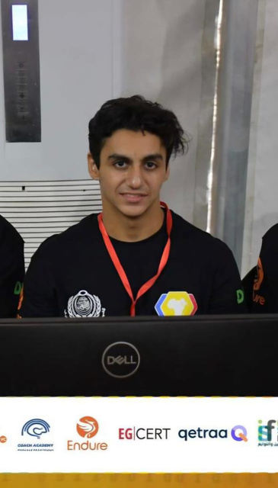
Team Members :
T.L.Shehab Gamal Abdelmaksoud
2-Mahmoud Reda Mohamed
3-Mahmoud Usama Sayed
4-Amr Mohamed Abelfattah

Slide 3
Supervised by
Eng.
Samah Eisa

Slide 4
Content
Introduction
Topology
Network Topology Overview
Executive Summary
VLANs
OSPF
VRRP
DHCP,
Inter VLAN
TELNET, AAA
PPP
NAT, ACL
RSTP
WLAN
Future
Enhancment
Conclusion

Slide 5
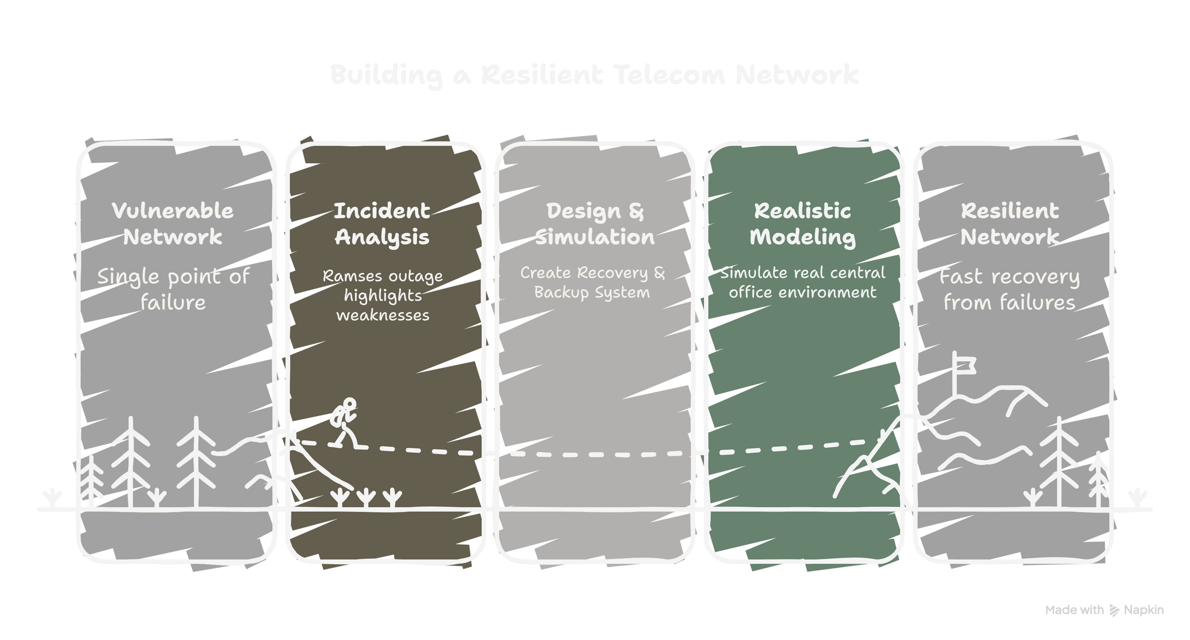
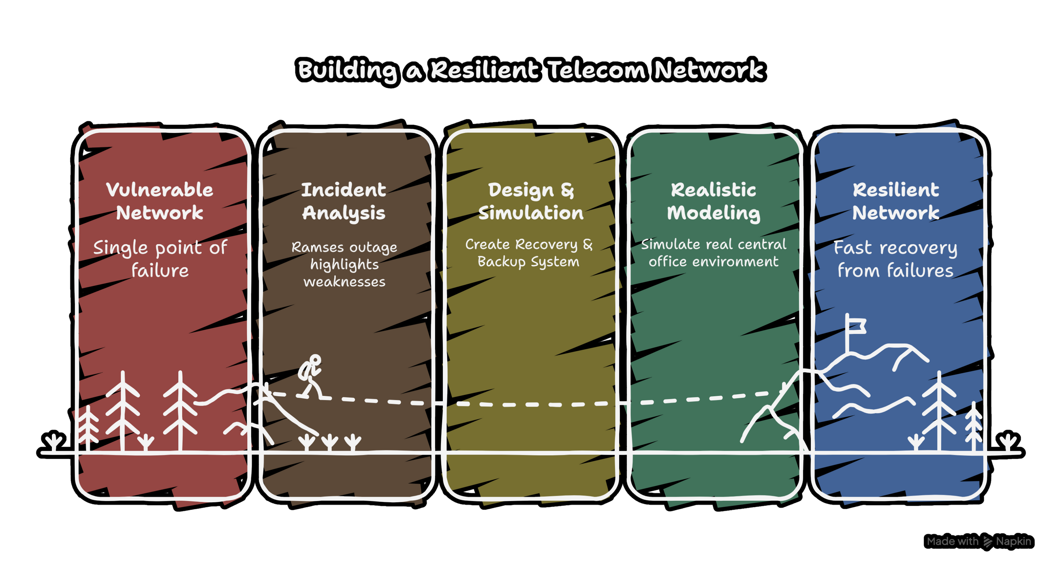
Introduction :

Slide 6
Introduction :
Inside every Zone, we created three independent home networks to simulate real-life scenarios such as:
Service distribution
DHCP allocation
Routing & OSPF convergence
VRRP gateway failover
Fault isolation
Wireless AP coverage
• We applied all technologies learned through HCIA and HCIP, including:
VLAN segmentation, OSPF routing, VRRP high availability, DHCP services, NAT, AC/AP wireless management, and STP optimization.
Our goal
To build a realistic, scalable, and resilient central office recovery model that meets professional telecom standards

Slide 7
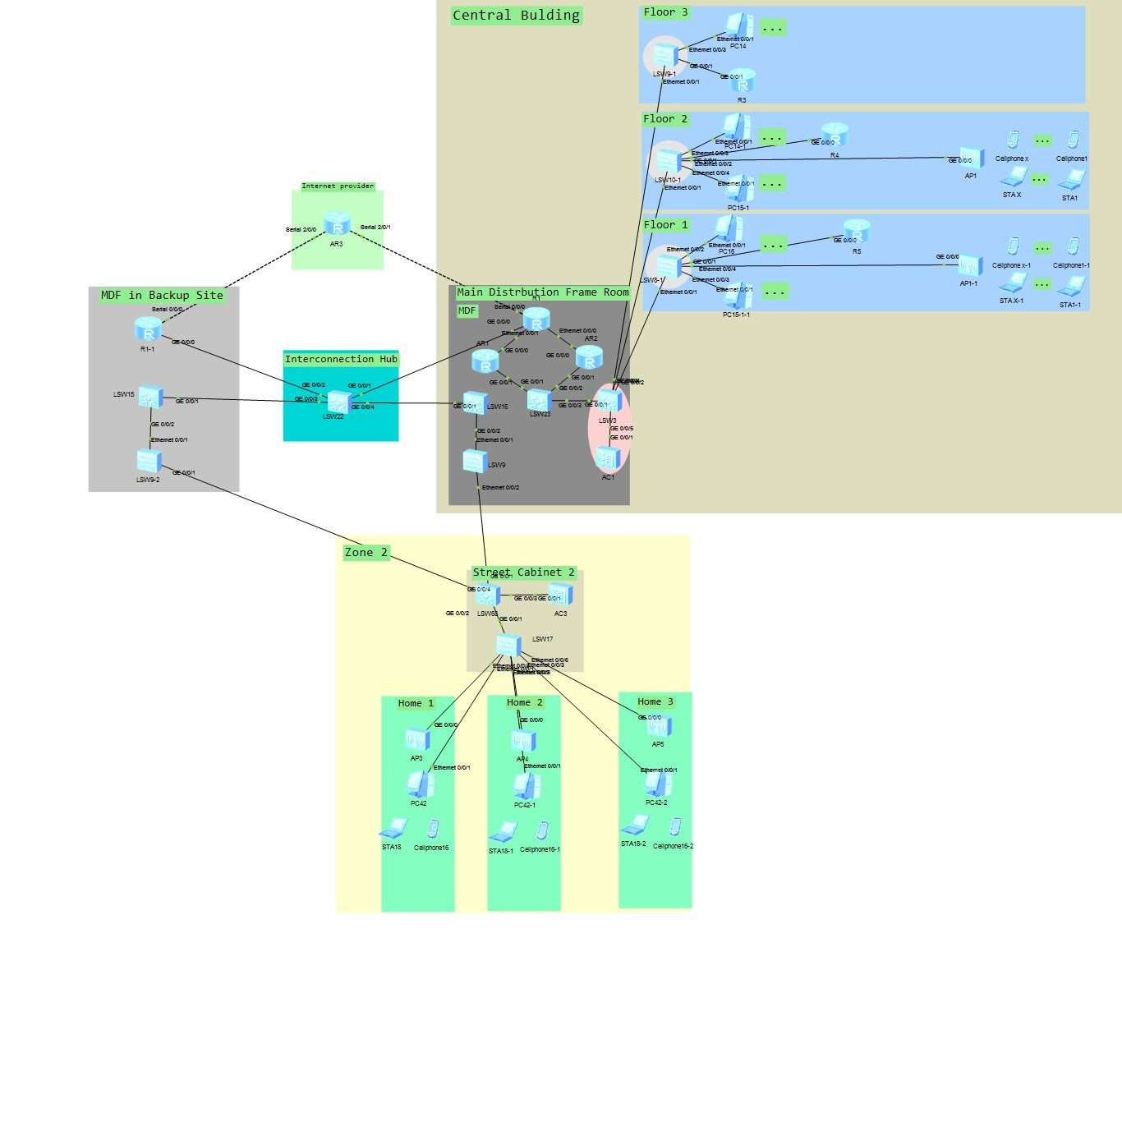
Topology :

Slide 8
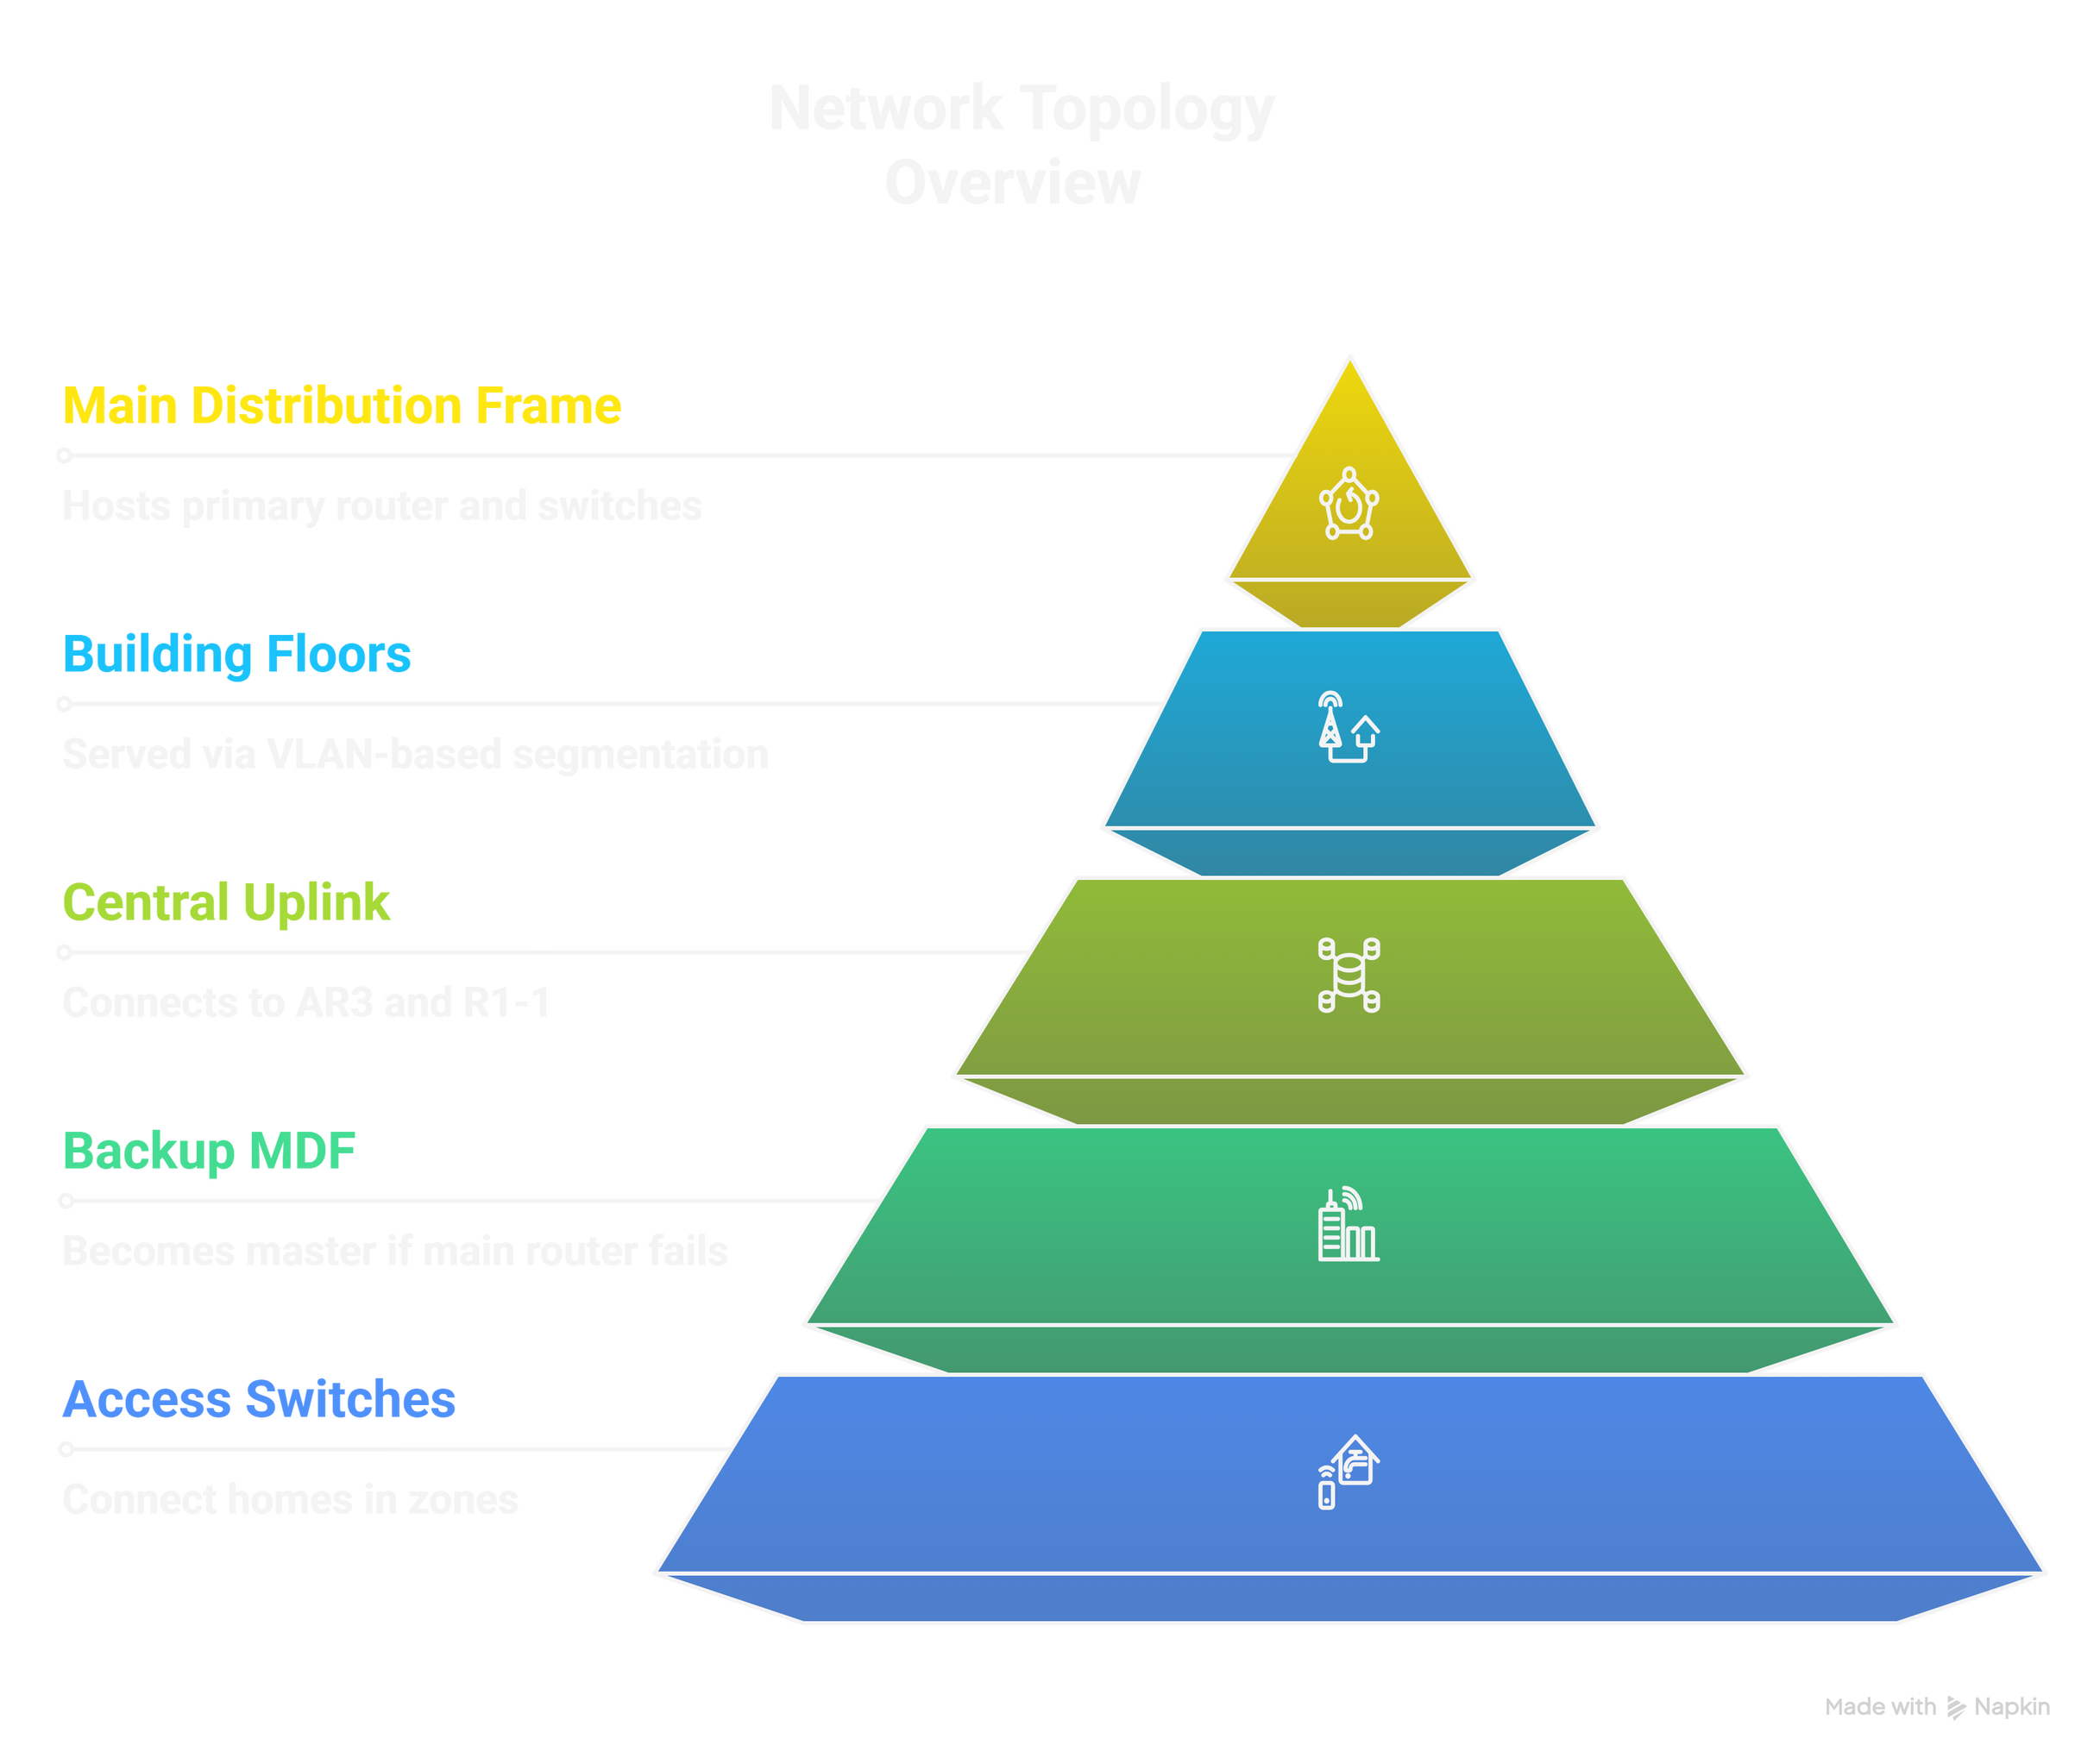
Network
Topology
Overview

Slide 9
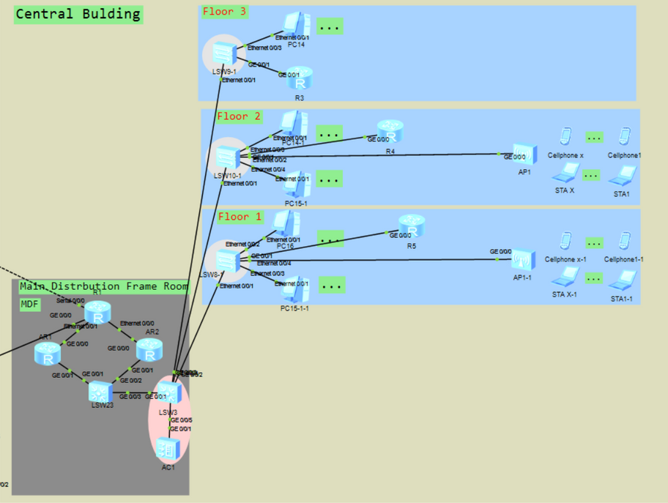
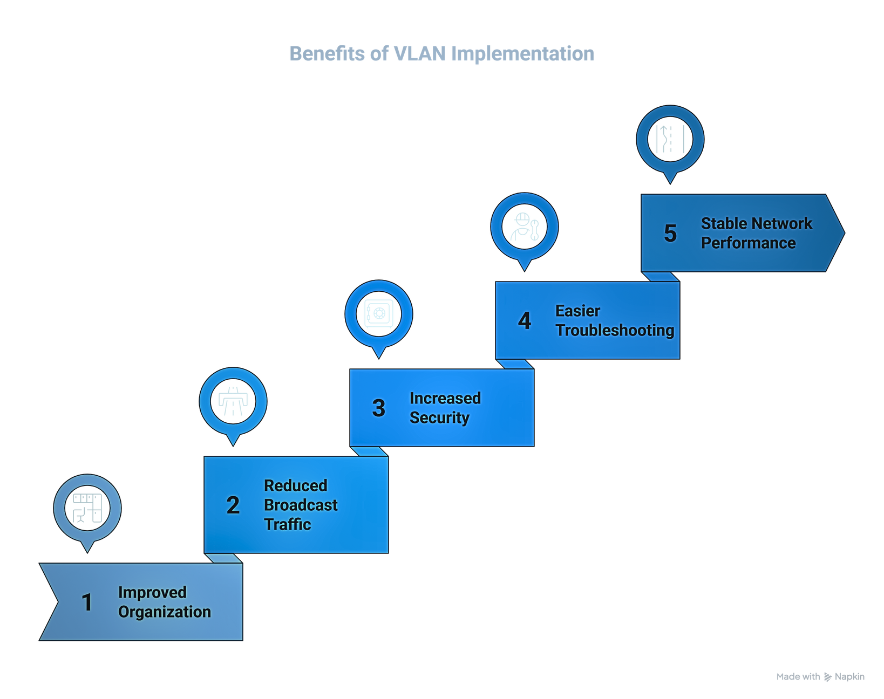
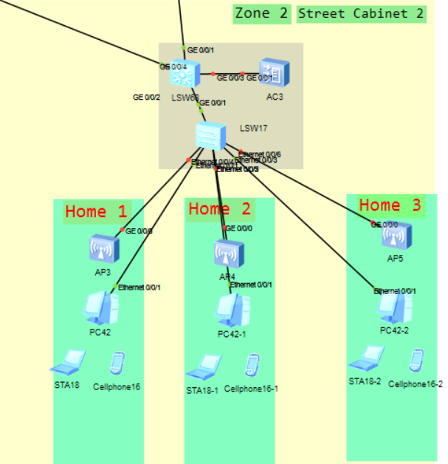
VLANs

Slide 10
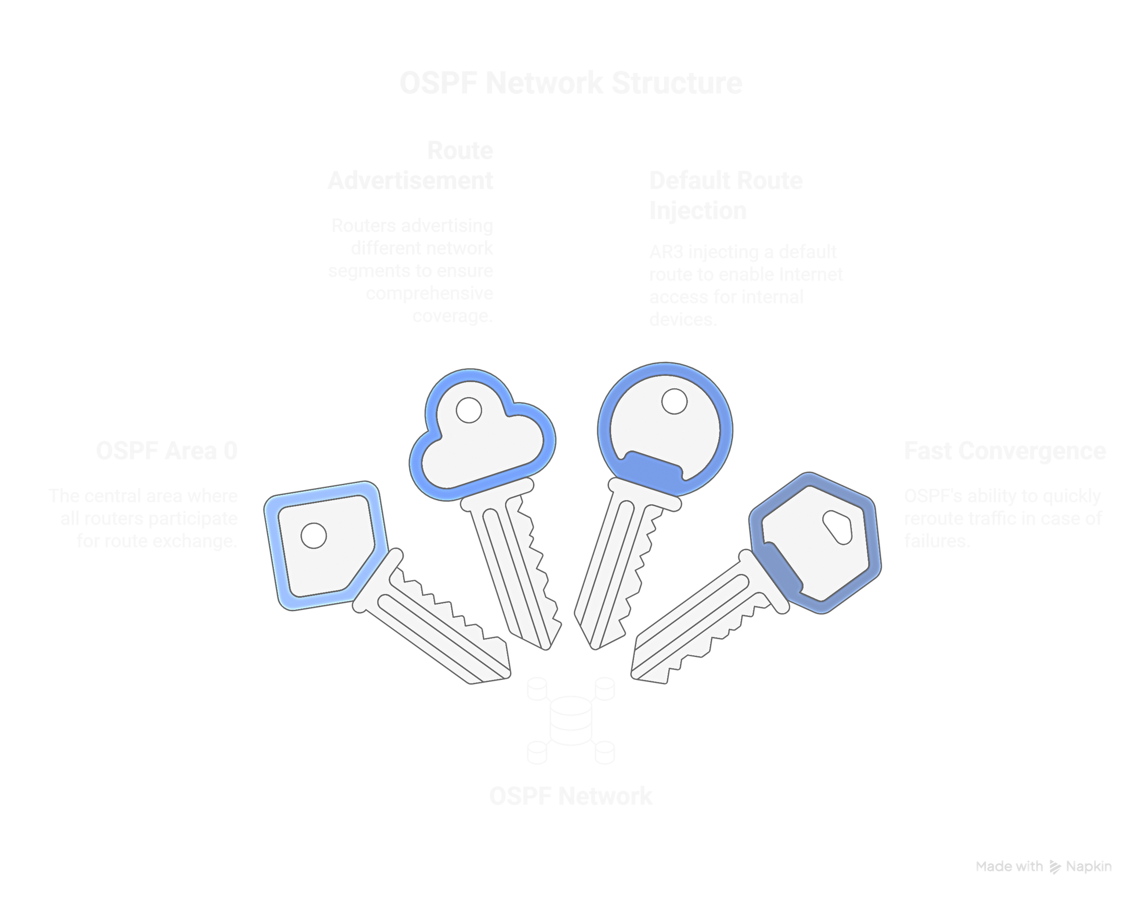

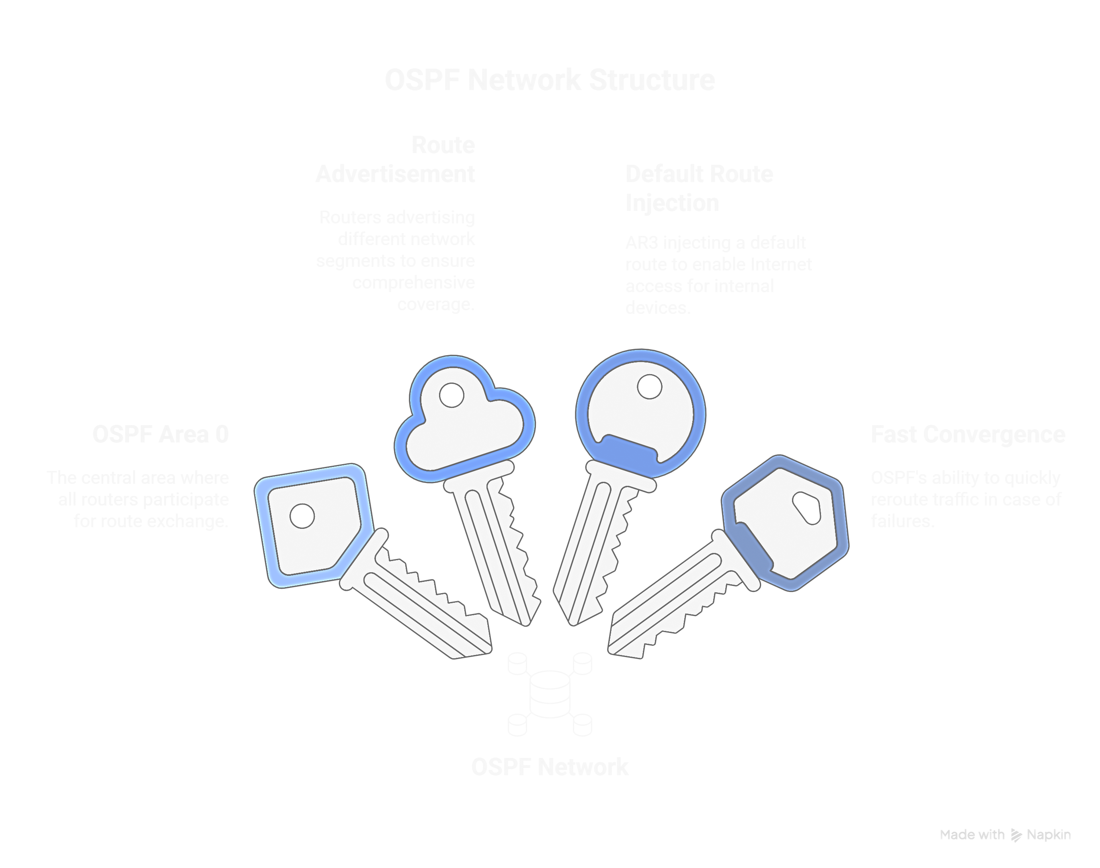
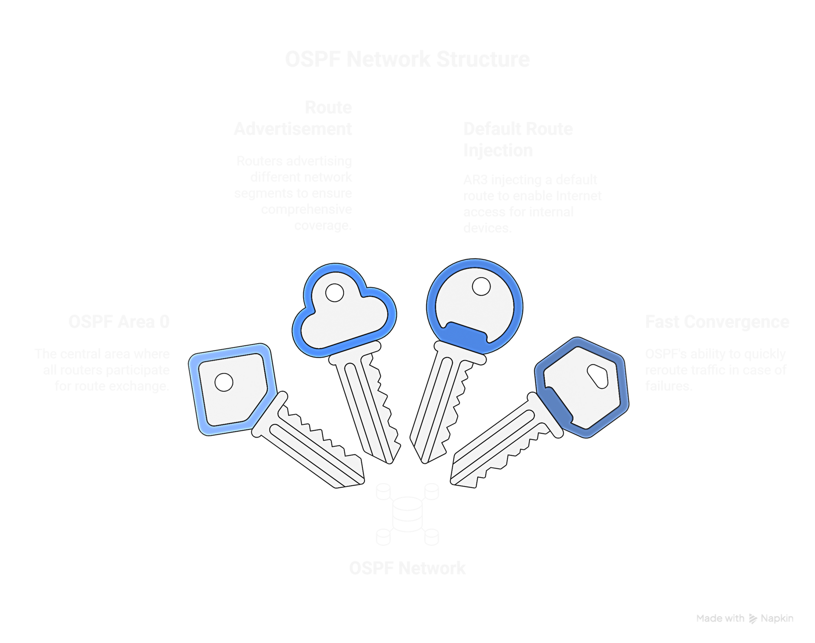

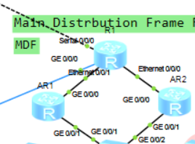
OSPF Protocol

Slide 11
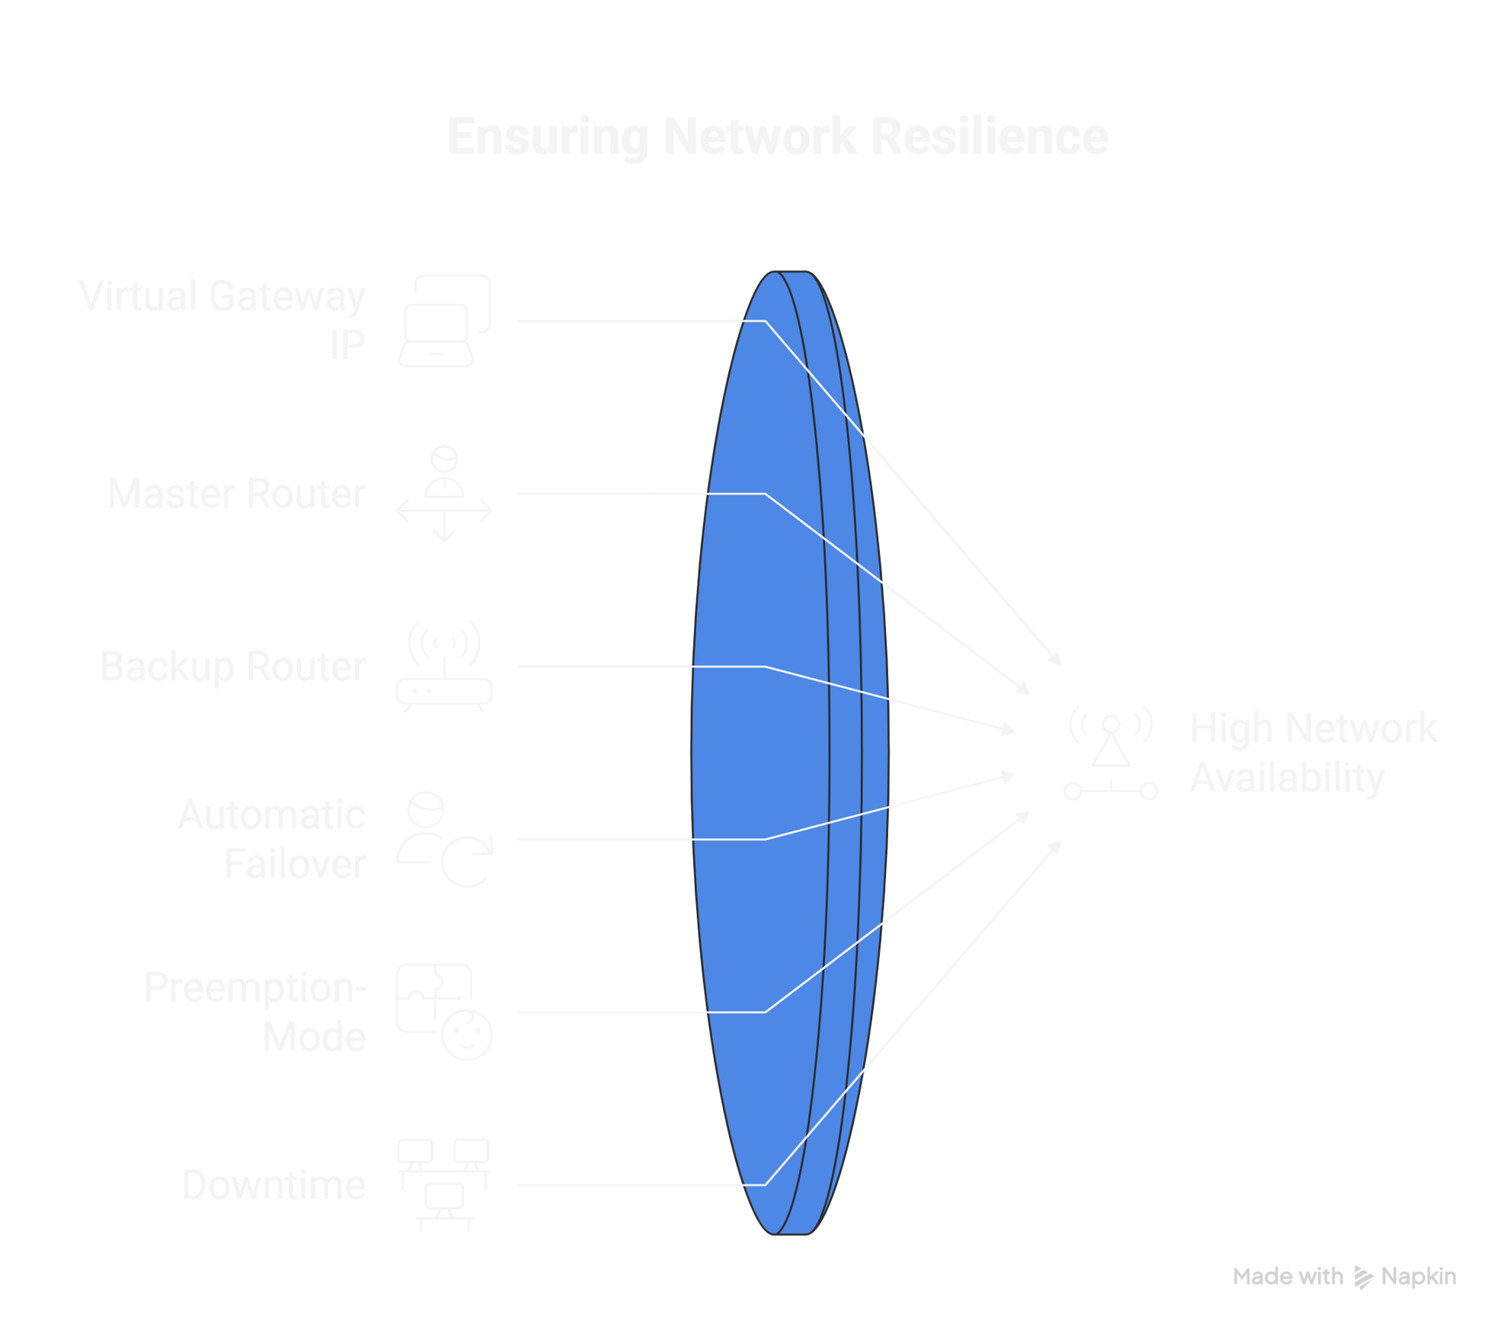
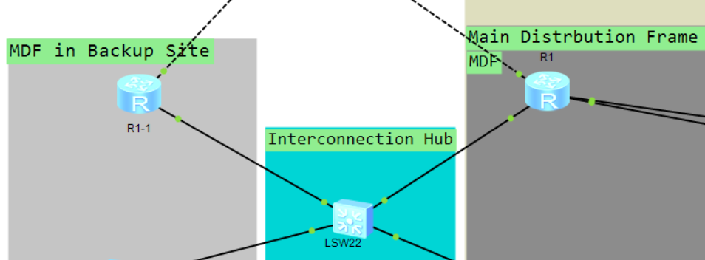
VRRP

Slide 12
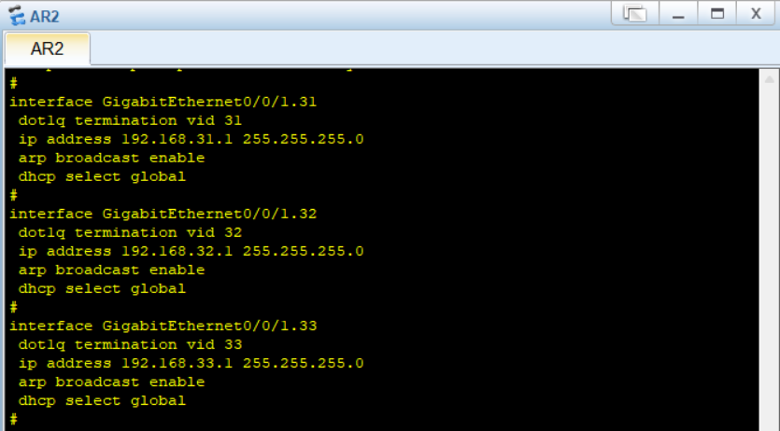
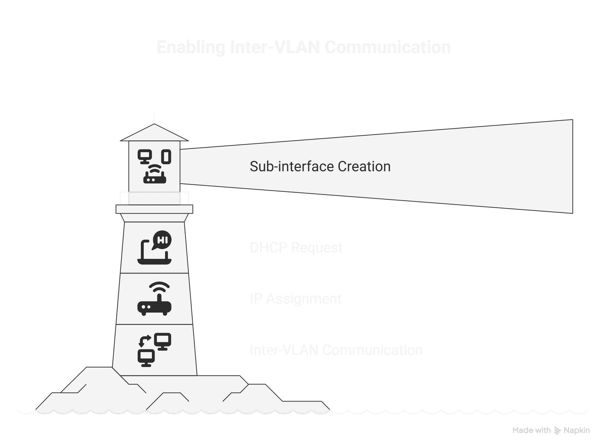
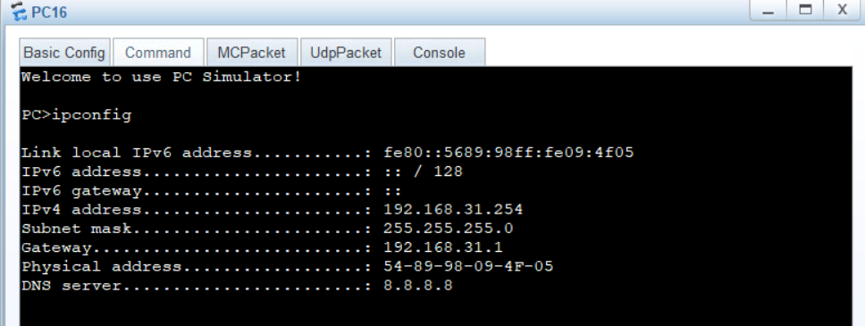
DHCP&Inter-VLAN

Slide 13
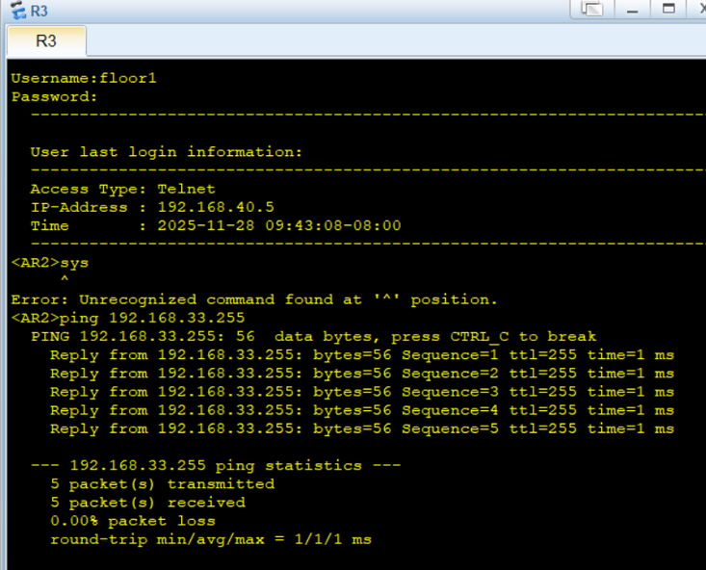
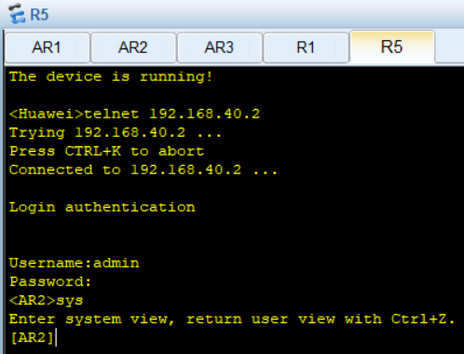
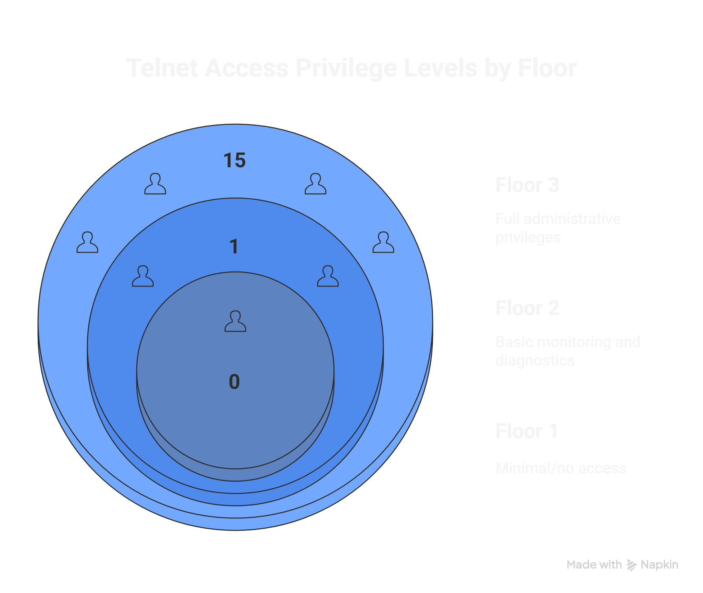
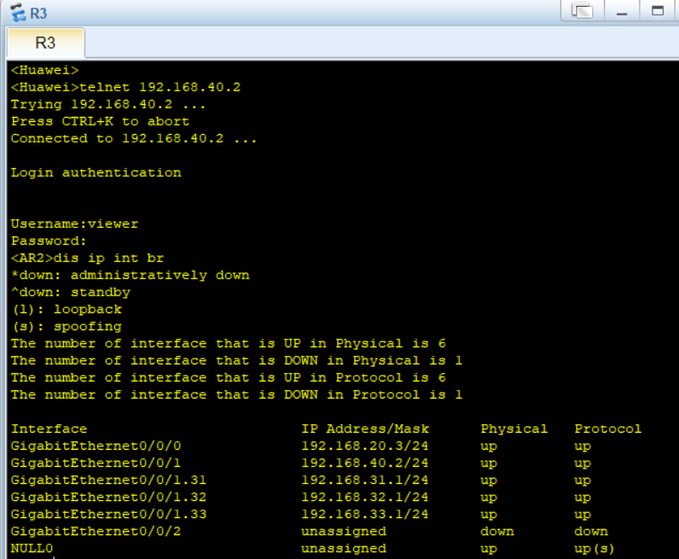
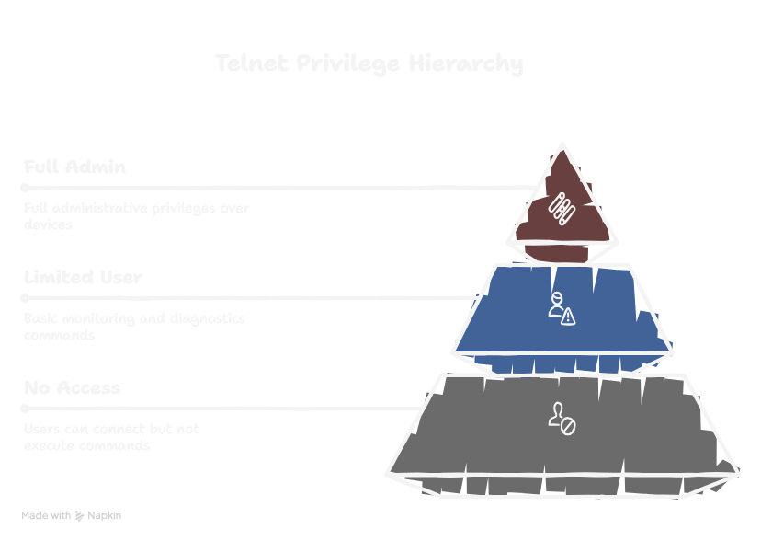
Telnet&AAA

Slide 14
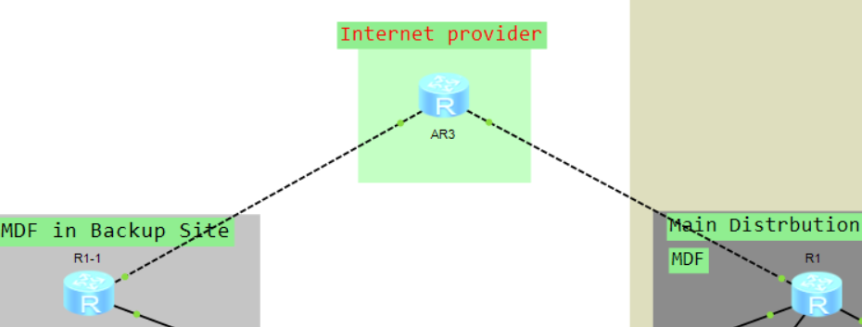
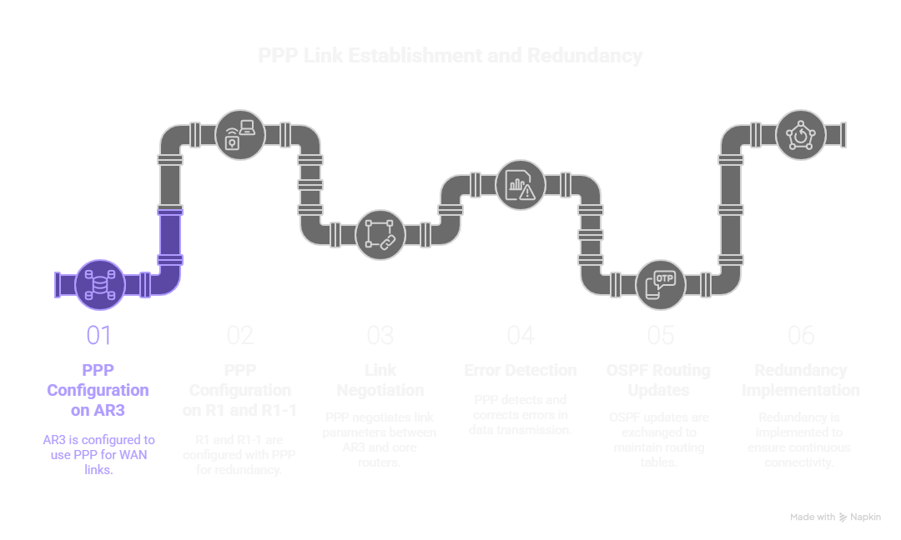
PPP

Slide 15
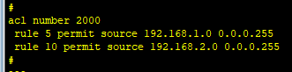
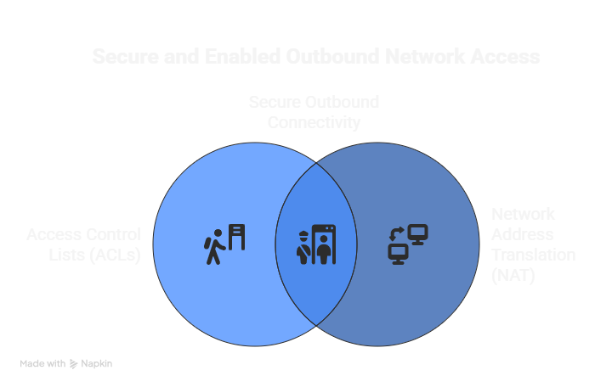
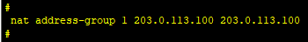
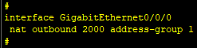
NAT&ACL

Slide 16
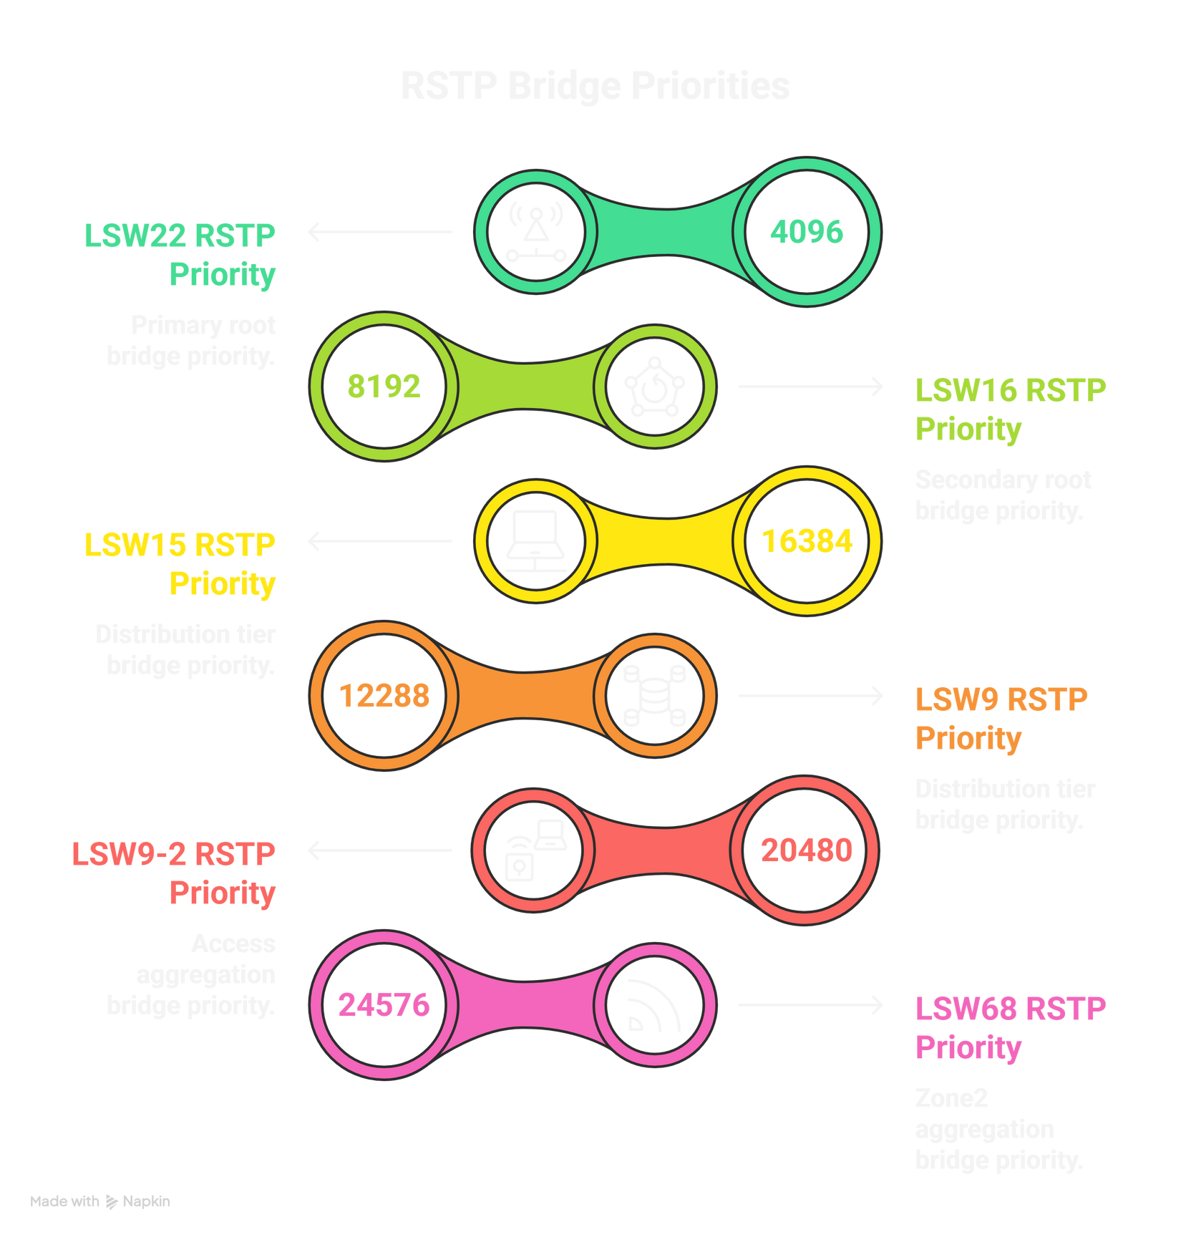
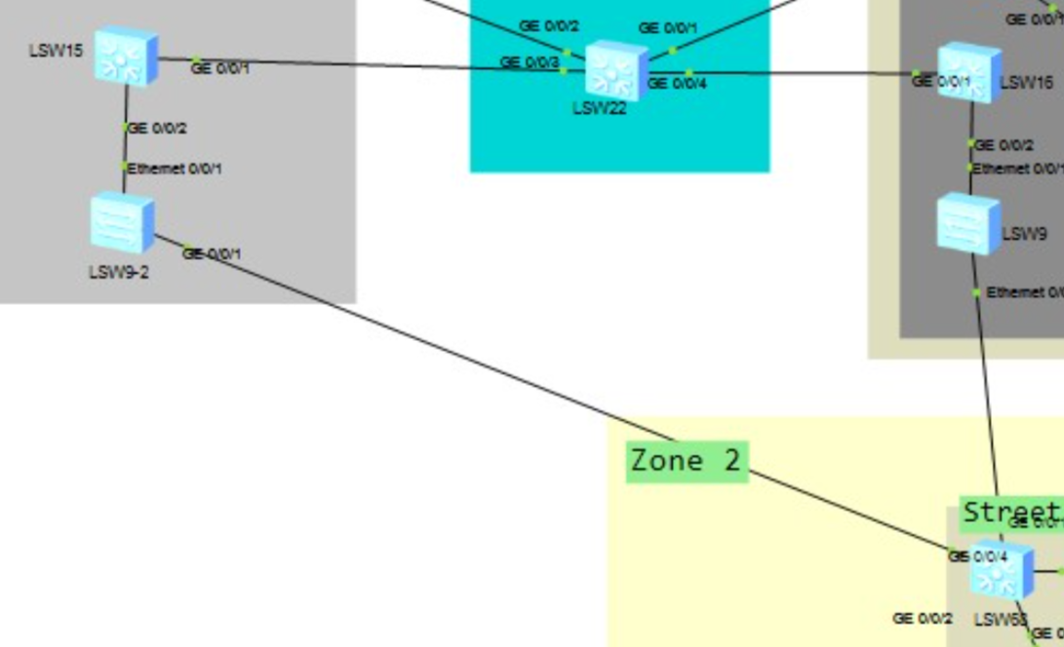
RSTP

Slide 17
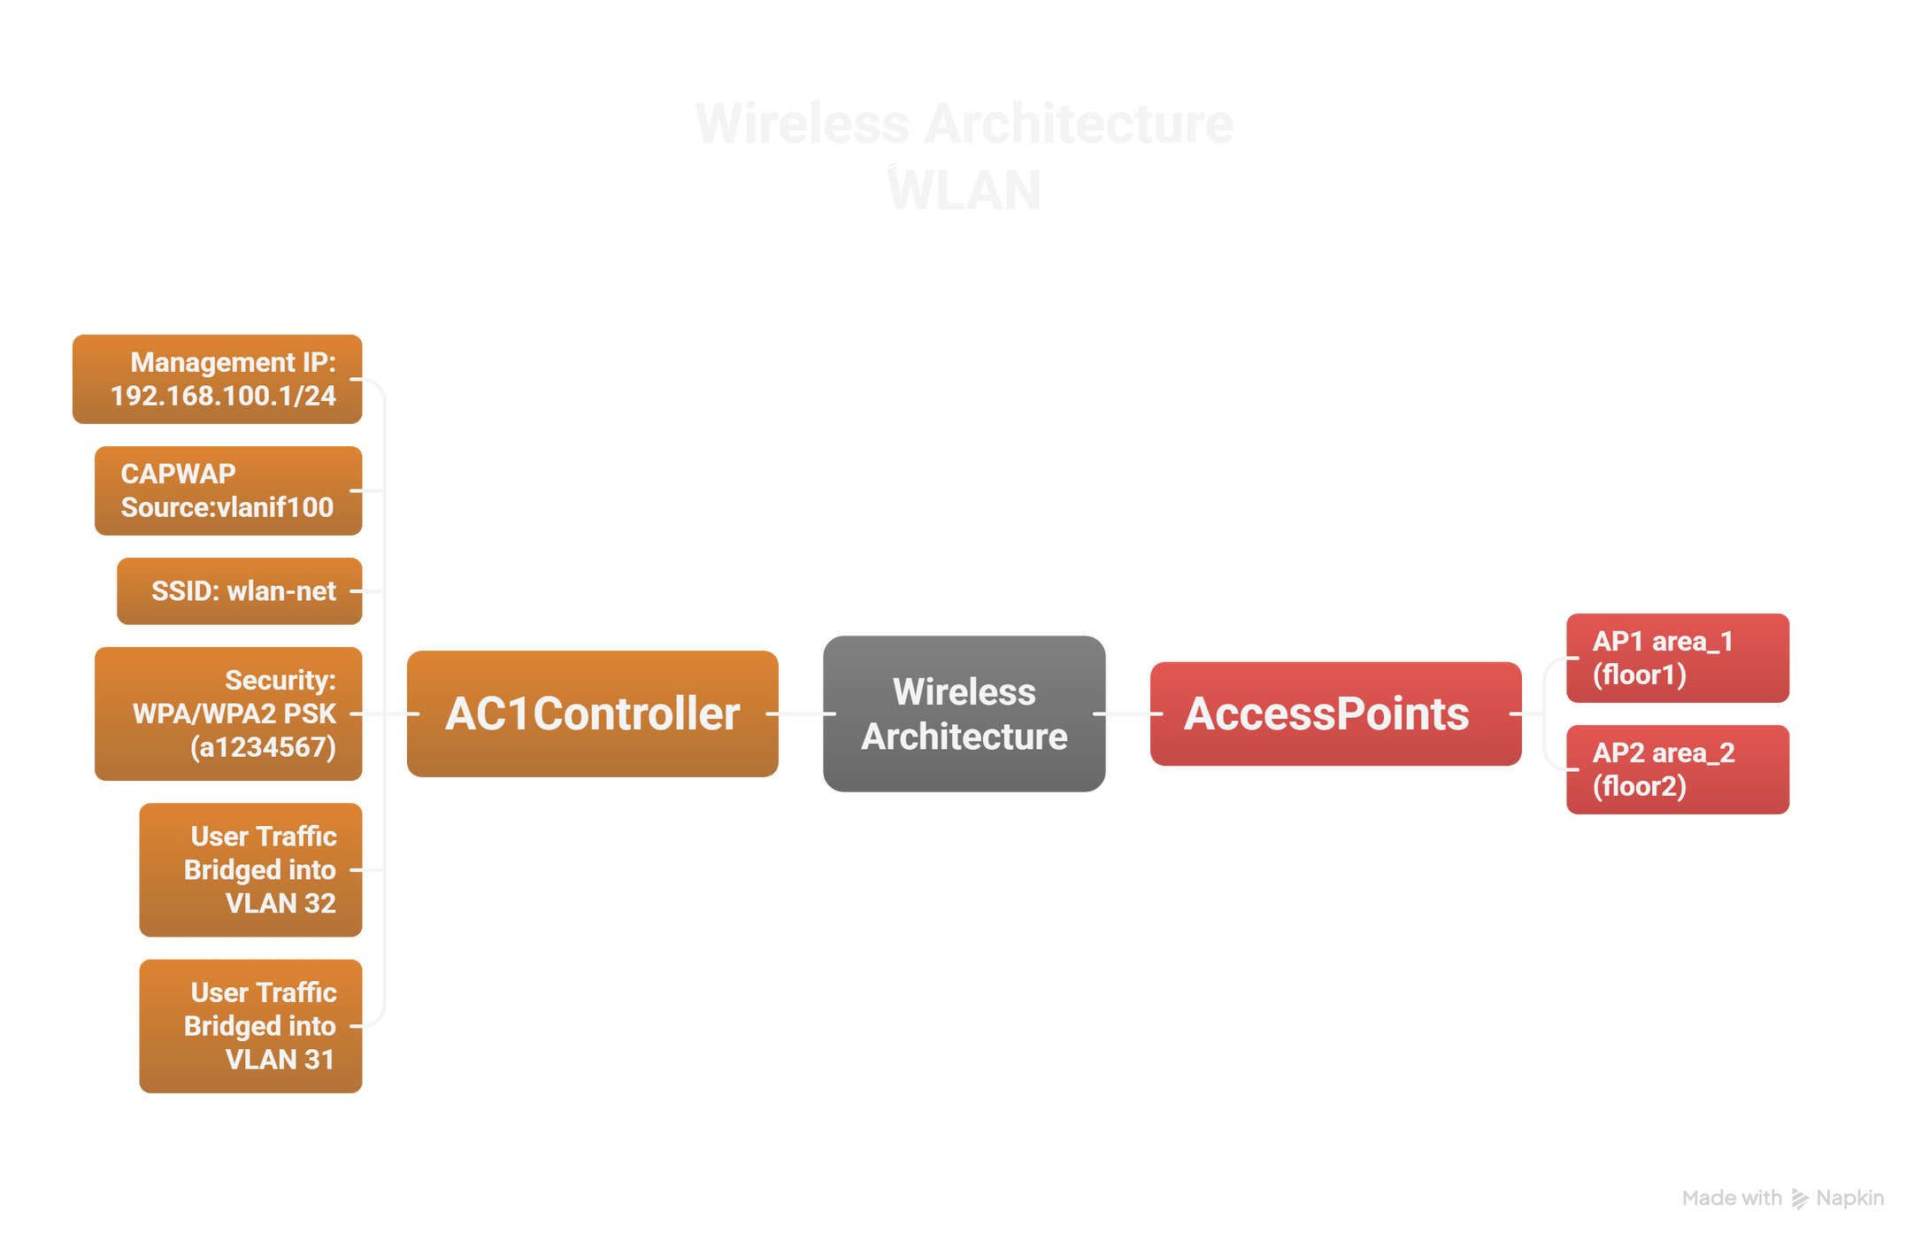
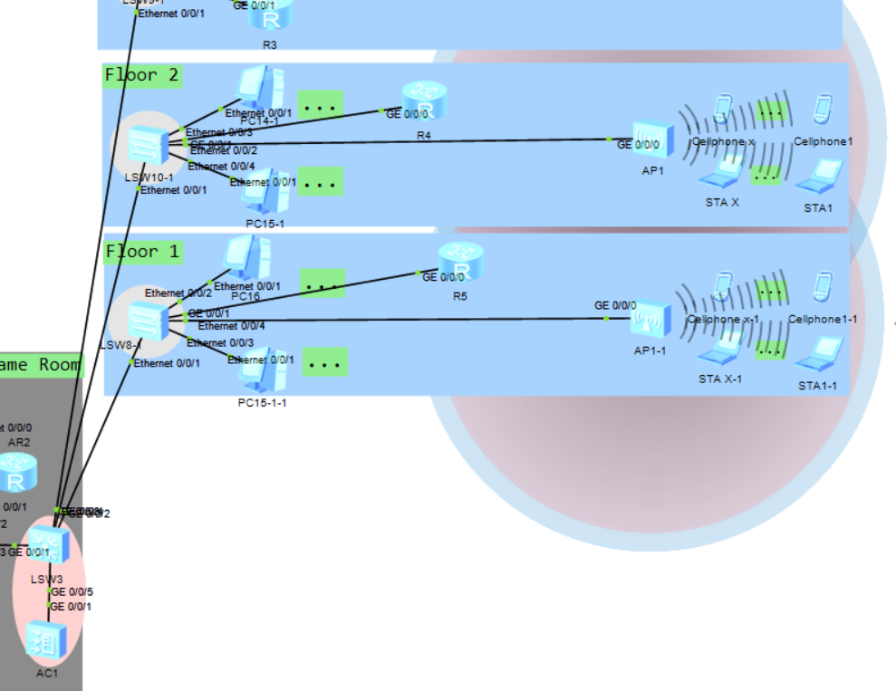
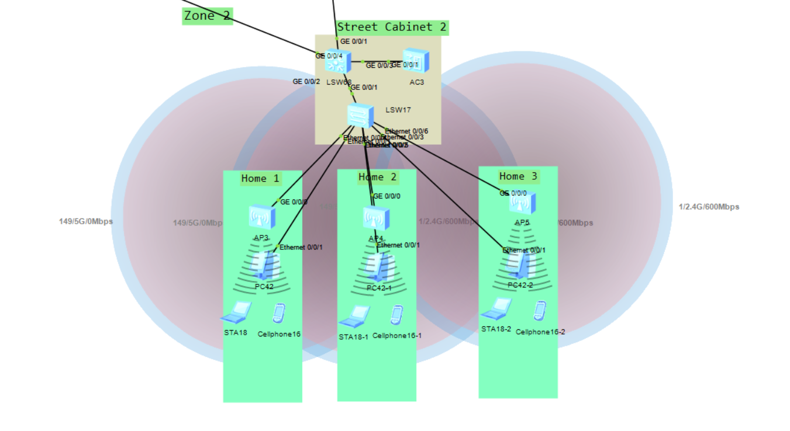
WLAN

Slide 18
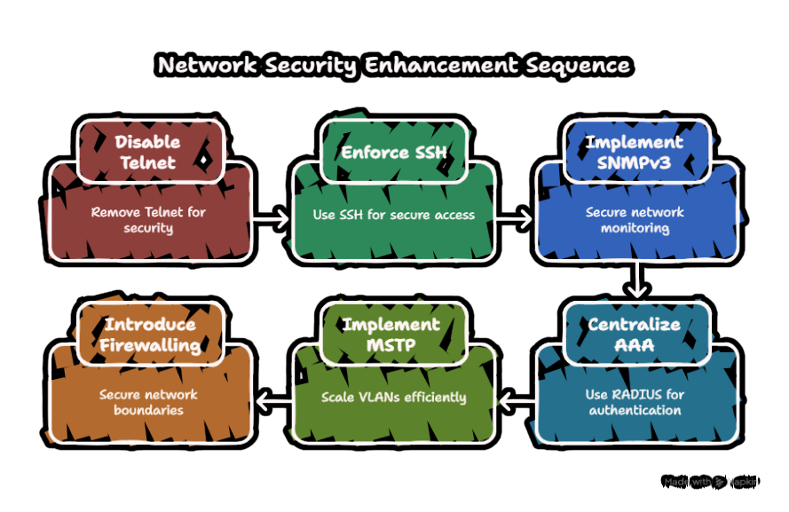
Future Enhancements

Slide 19
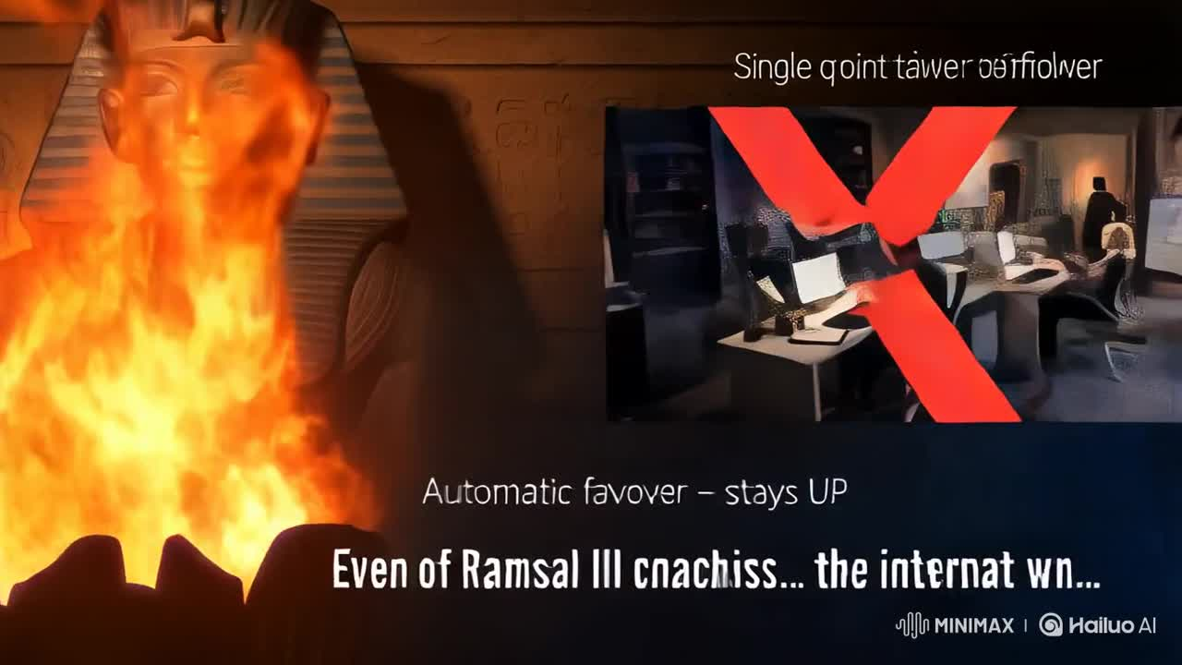
Conclusion

Slide 20
Huge Thanks To:
Samah Eisa
Supervisor .
&

